Slide 1
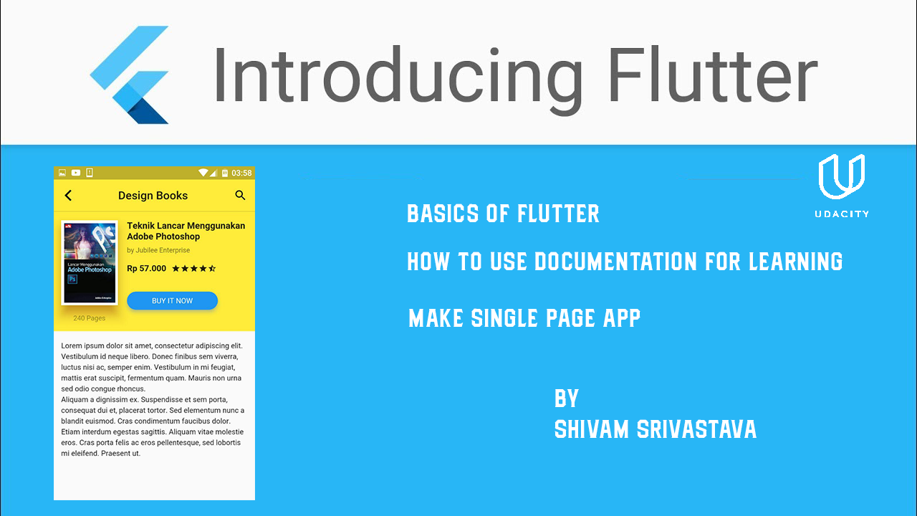
STATUS SUMMARY

Slide 2

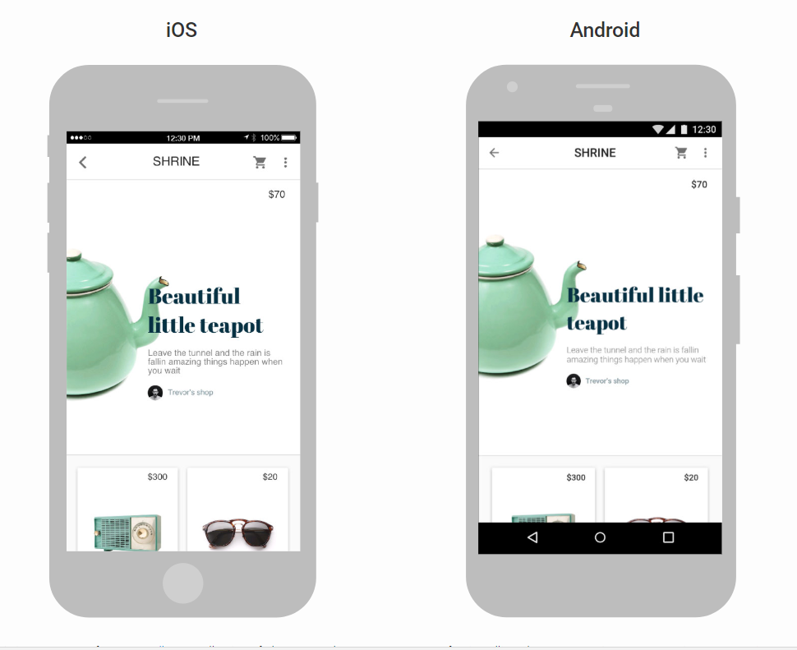
What is Flutter
What is Flutter?
multi-platform - Android & iOS
high performance, low latency
DART as main language - open-source / github
custom ui-rendering engine

Slide 3

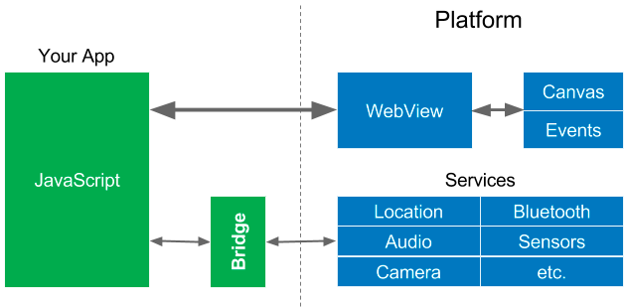
Cordova
HTML, JavaScript, CSS

Slide 4

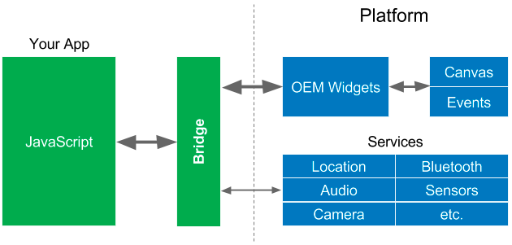
React Native
ReactJS

Slide 5
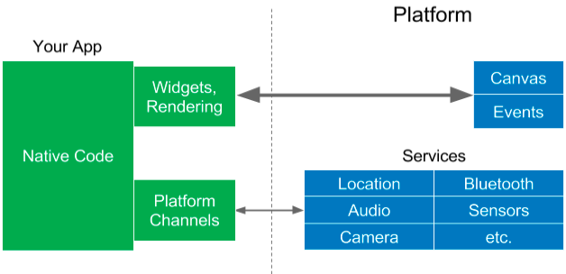
Flutter
Dart

